Slide 1
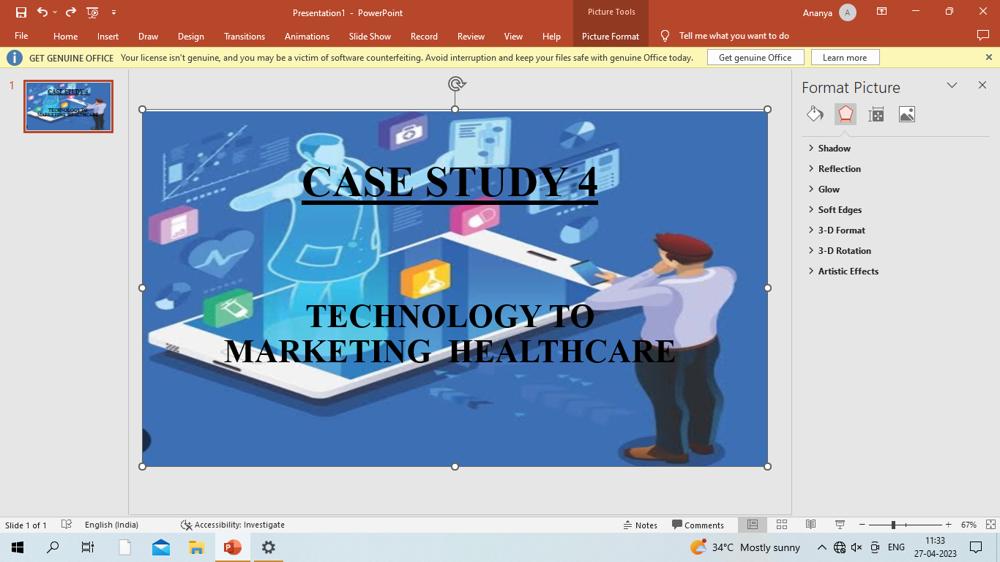
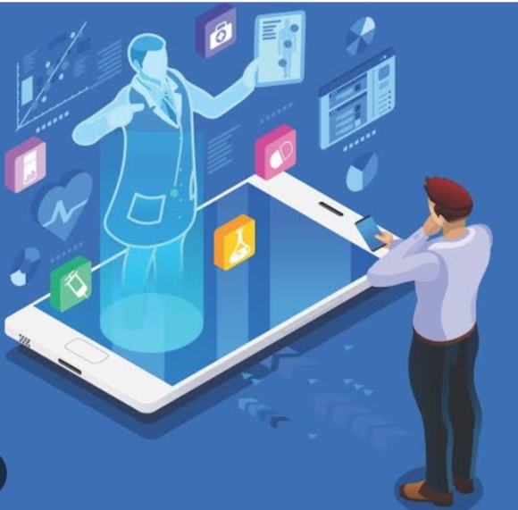
CASE STUDY 4
TECHNOLOGY TO MARKET IN HEALTHCARE
DONE BY
Tanushri, khyti, Priyanka, laxmi, latha

Slide 2

INTRODUCTION
Over the past few years, technology has become a major factor of competition in the entire healthcare industry. The quality of facilities plays an important role in shaping health care programs. Due to its low price, precise detection and resolution, technology complements to the needs of the hospital in an effective way.

Slide 3

TELIMEDICINE
Telemedicine can help provide remote access to healthcare services, enabling patients to receive medical care from their homes or remote locations.

Slide 4


Slide 5
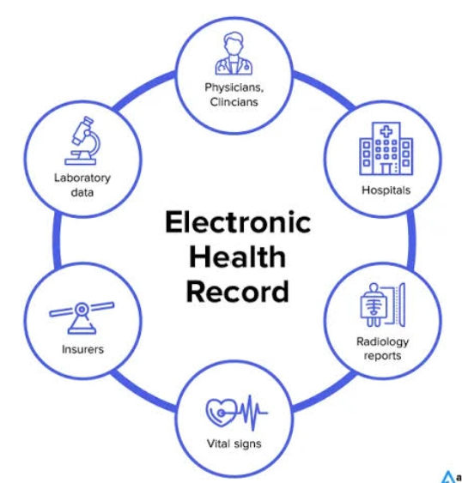
ELECTRONIC HEALTH RECORDS (EHR)
EHRs can help improve patient safety, reduce medical errors, and enable efficient sharing of patient information between healthcare providers.

Slide 6

ARTIFICIAL ELLIGENCE(AI)
AI can help to improve disease diagnosis, identify high-risk patients, and improve medication adherence.

Slide 7


WEARABLE DEVICES
Wearable devices can help patients monitor their health and track their progress towards health goals.
However, there are several challenges when it comes to leveraging technology in healthcare, including:
Data privacy and security- Healthcare organizations need to ensure that patient data is secure and comply with regulations such as HIPAA.

Slide 8
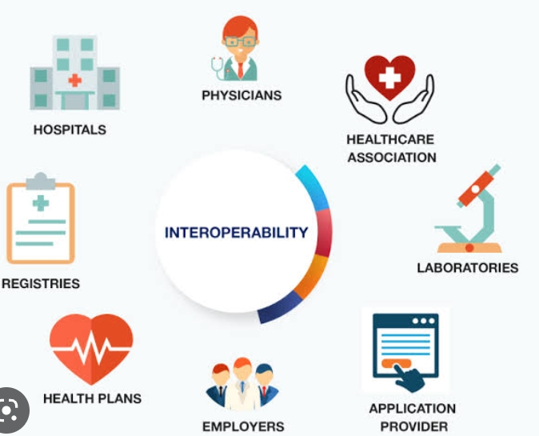

INTROPERABILITY
Healthcare organizations need to ensure that technology solutions can integrate and communicate with each other to enable seamless sharing of patient data.

Slide 9
ADOPTION
Healthcare providers may be reluctant to adopt new technology solutions, which can limit their effectiveness.
COST
Implementing new technology solutions can be expensive, especially for smaller healthcare providers.
To overcome these challenges, healthcare organizations can take the following steps:
Invest in secure data storage and transfer solutions that use encryption, access controls, and regular audits to protect patient data.

Slide 10
Implement standardized protocols for data exchange to ensure interoperability between different technology solutions.
Provide training and education to healthcare providers to increase adoption and use of new technology solutions.
Identify cost-effective solutions that can provide the desired benefits while minimizing costs.
In terms of securing data, healthcare organizations can use various measures, including:
ENCRYPTION
Encrypting sensitive data both in transit and at rest can ensure that even if an attacker gets hold of the data , they will not be able to read it.

Slide 11
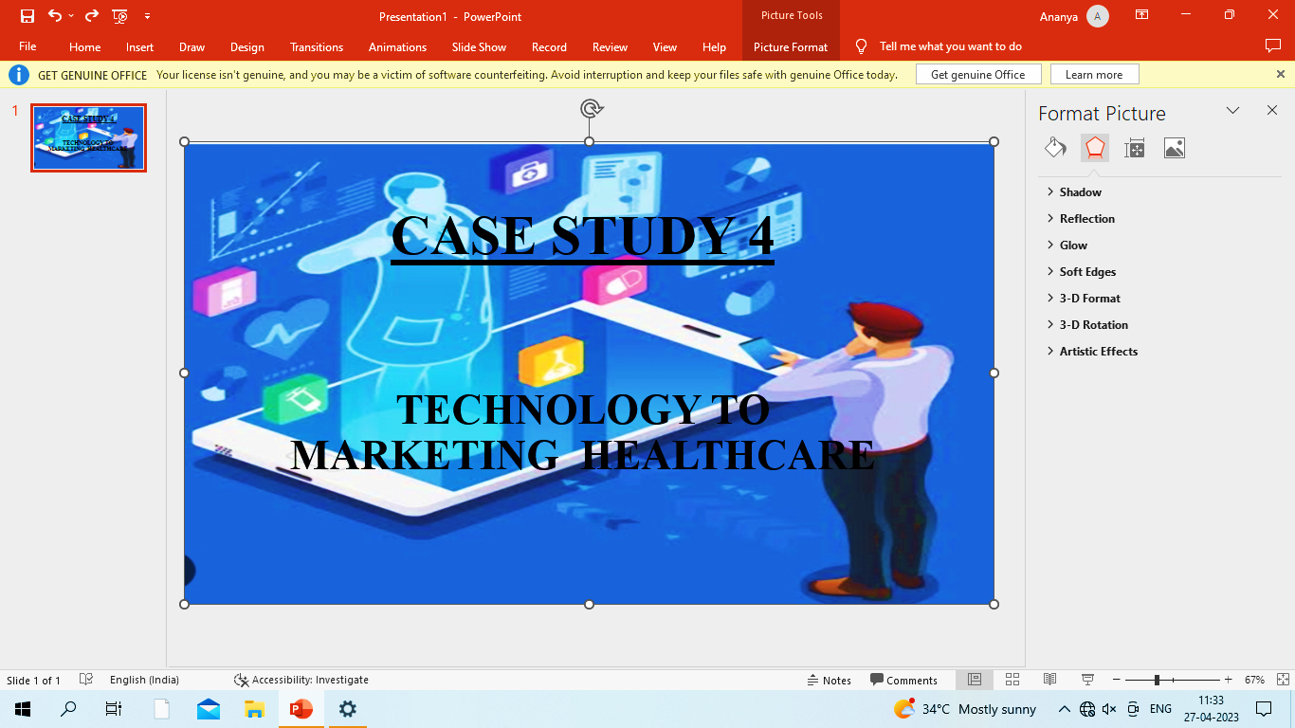

ACCESS CONTROLS
Implementing access controls to limit access to sensitive data to only authorized personnel can prevent unauthorized access.
REGULAR BACKUPS
Regularly backing up data can ensure that if data is lost or corrupted. It can be easily recovered.

Slide 12
MONITORING AND LOGGING
Monitoring and logging data access can help detect unauthorized access and provide an audit trail for forensic analysis.
CONCLUSION
We conclude that health information technology improves patients safety by reducing medication errors, reducing adverse drug reactions, and improving compliance to patience guidelines. There should be no doubt that health information technology is an important tool for improving healthcare quality and safety.

Slide 13
THANKYOU

